Slide 1




Slide 2









CODE VERSE HACKATHON 2025
Problem Statement Title : Adaptive Travel Itinerary System: Real-Time Dynamic Adjustments Based on Live Events and User Feedback.
Team Name : CodeX4
Team Members : Jayesh Khandelwal, Srushti Panara, Mugdha Phalak, Tanmay Pokale

Slide 3



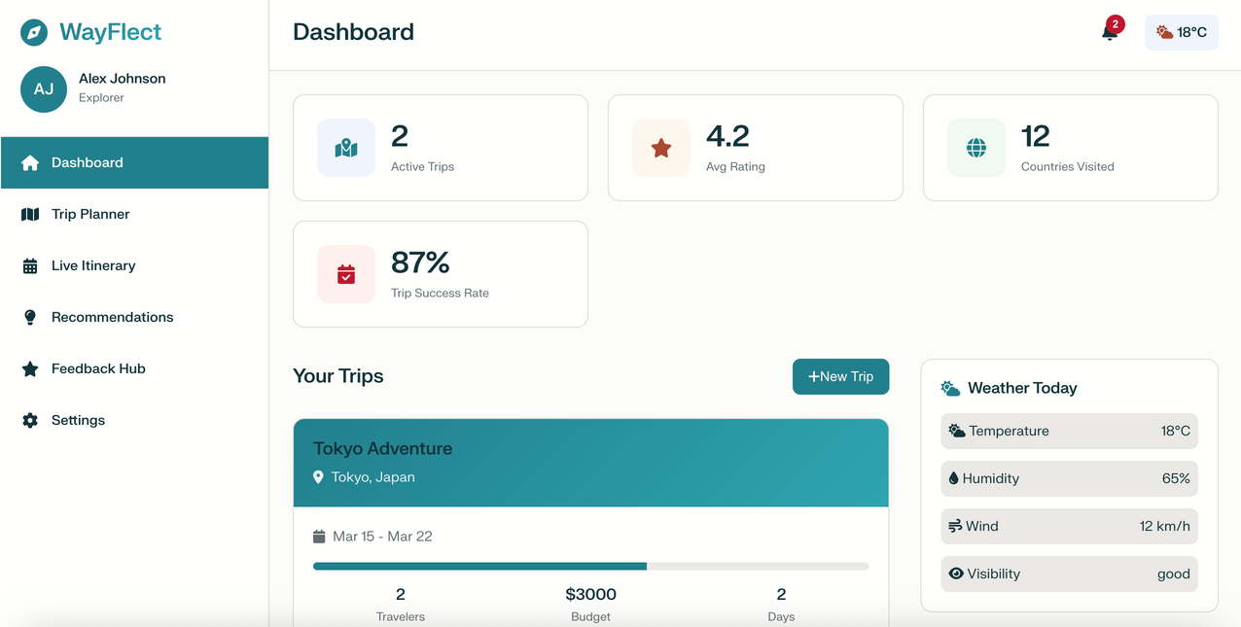


Adaptive Travel Planning with AI & Live Data
Real-time adaptive itinerary system
Integrates weather, traffic & event APIs
AI + user feedback loop for personalization
Instant rescheduling & alternative suggestions
How It Addresses the Problem
Reacts to sudden changes (weather, traffic, cancellations)
Saves travelers time, energy & stress
Learns preferences and adapts automatically
Innovation & Uniqueness
Dynamic rescheduling engine (vs. static apps)
Multi-API integration for real-time accuracy
AI-powered personalization that improves with use
Traveler-first design for stress-free experience

Slide 4





















TECHNICAL APPROACH

Slide 5
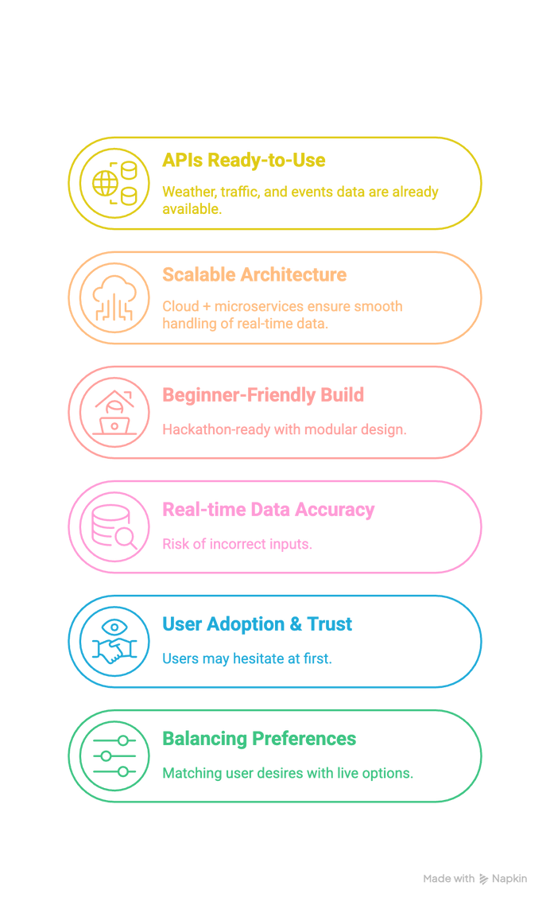
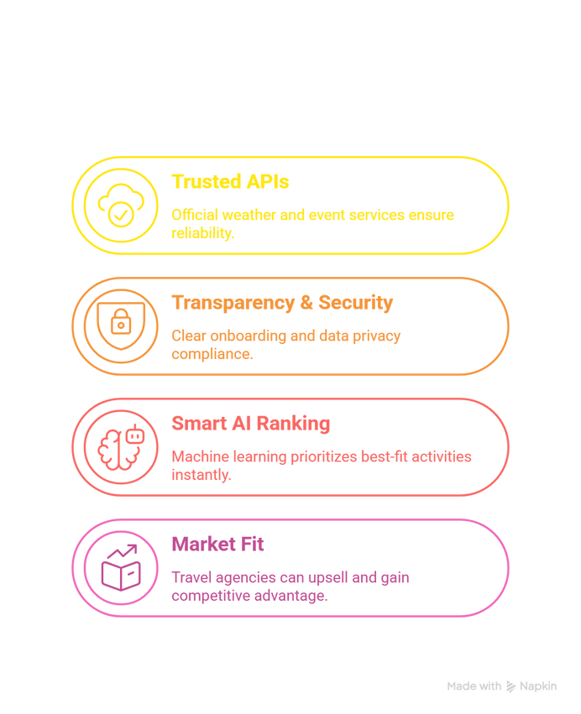
Feasibility
Viability

Slide 6
IMPACT AND BENEFITS
FOR TRAVELERS | FOR TRAVEL AGENCIES
Personalized and seamless experience. | Increased customer satisfaction through personalized service.
Stress free travel with real-time updates. | Better utilization of services and resources.
Time and energy savings by avoidinig unexpected delays. | Opportunities for upselling based on user behaviour.

